Slide 1



MSc in Business Analytics - Part time
Data Management & Business Intelligence
2nd Assignment
Gkourioti Panagiota - P2822109
Koletsi Thaleia - P2822120

Slide 2







Overview
Data Source
System Workflow/ Architecture
Data Transformation
Building the Data warehouse
Multidimensional Cube Development
Live Dashboards/ Scenarios
Findings

Slide 3
Problem Scope
Online hospitality marketplace
Aim: utilize data profitably
Examine assumptions about prices, ratings, hosts

Slide 4

Dataset
“Airbnb dataset” for Amsterdam and Berlin
Data source : Kaggle.com
4 Raw CSV files - 226 columns
44,799 listings
16,351,640 daily prices
37,932 hosts

Slide 5


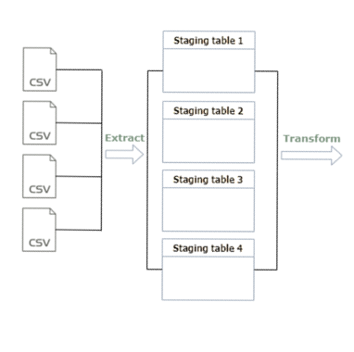
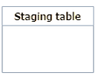
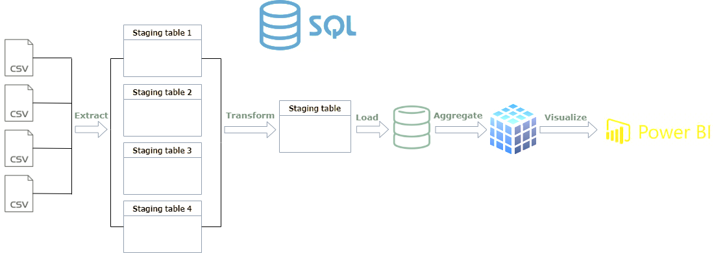
System Workflow

Slide 6

Data cleaning & transformation
filtering out unnecessary information
handling missing data
modifying format and structure of data
summarizing and mapping to new columns
ensures compatibility with destination system
data becomes more comprehensive and manageable

Slide 7

Building the data warehouse
Dimensions
Fact tables
ID
bedrooms
accommodates
listing key
extra people 2
location id
property category
PropertiesDim
listing ID
room type
host ID
REVIEWS
property type
FactListings
host id
cancelation policy
bathrooms
availabity_365
cleaning_fee
HostsDim
ID
host name
host ID
host is superhost
host acceptance rate
host id
host response rate
locationID
Dimensions with hierarchies
FactHosts
total listings
total entire homes
longitude
latitude
total private rooms
city ID
city name
total shared rooms
LocationDim
CityDim
city ID
availability
location id
listing id
maximum nights
FactCalendar
minimum nights
DateDim
MonthDim
YearDim
price
date id
date ID
month ID
year ID
date
month
year
month ID
month number
year ID

Slide 8

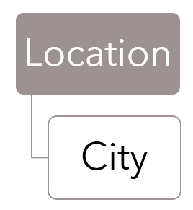
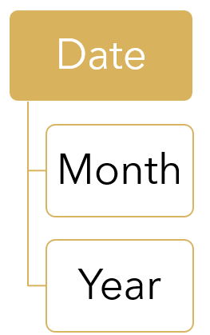
Multidimensional cube development
Define Hierarchies

Slide 9
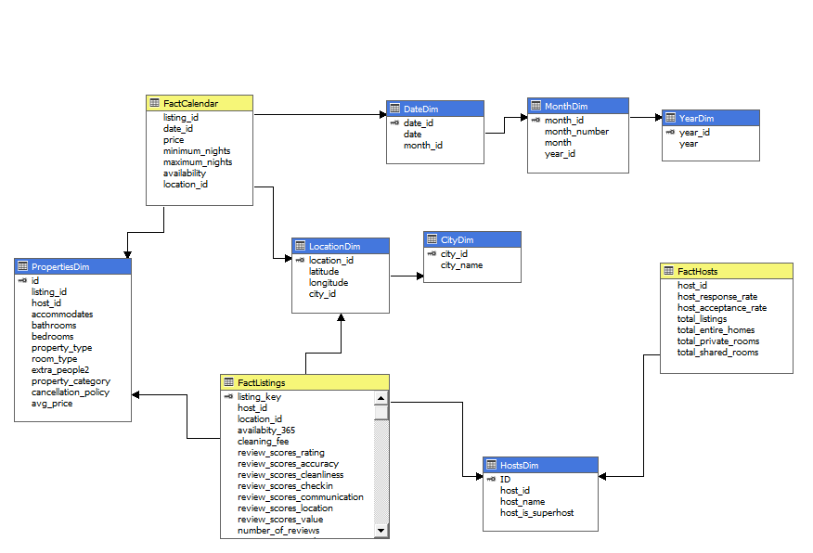

Schema

Slide 10
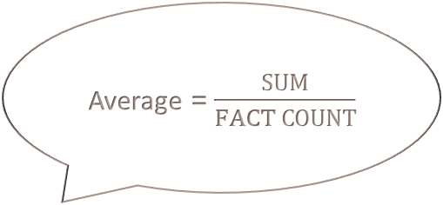

Calculations - measures
Average = $\frac{SUM}{FACT COUNT}$
Avg_price, Cleaning fee
Avg_accuracy, Avg_location, Avg_communication, Avg_value, Avg_cleanliness, Avg_number_of_reviews, Avg_reviews_per_month, Avg_total_ratings
Occupancy rate
Occupancy rate = 1 - $\frac{\frac{AVAILABILITY}{365}}{FACT COUNT}$
Response rate, Acceptance rate
Minimum nights

Slide 11
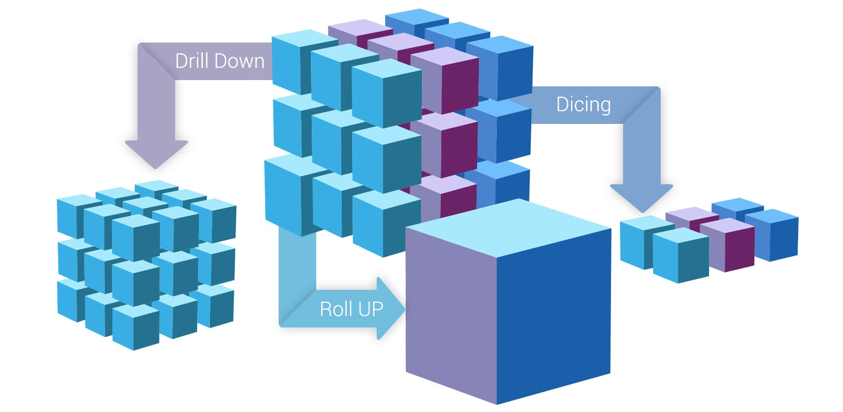
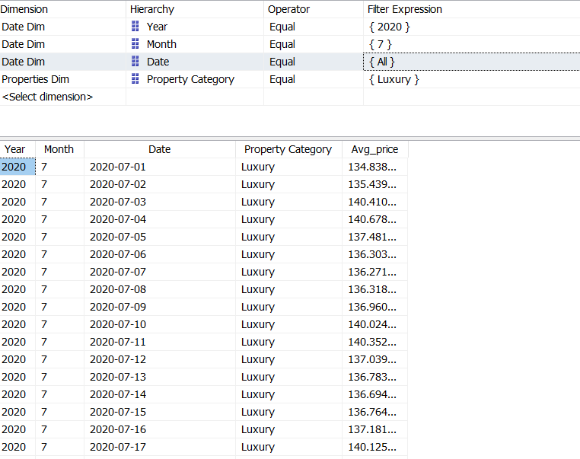
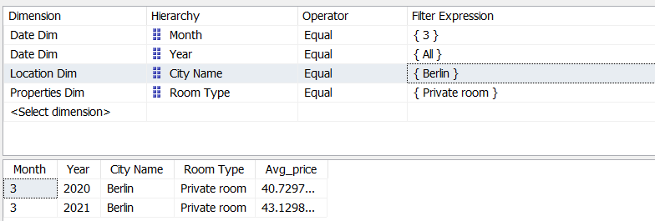
OLAP Reports
Average price of luxury properties in all available dates of July 2020.
Drill down
Average price of private rooms in Berlin and in March of all years.
Roll up

Slide 12
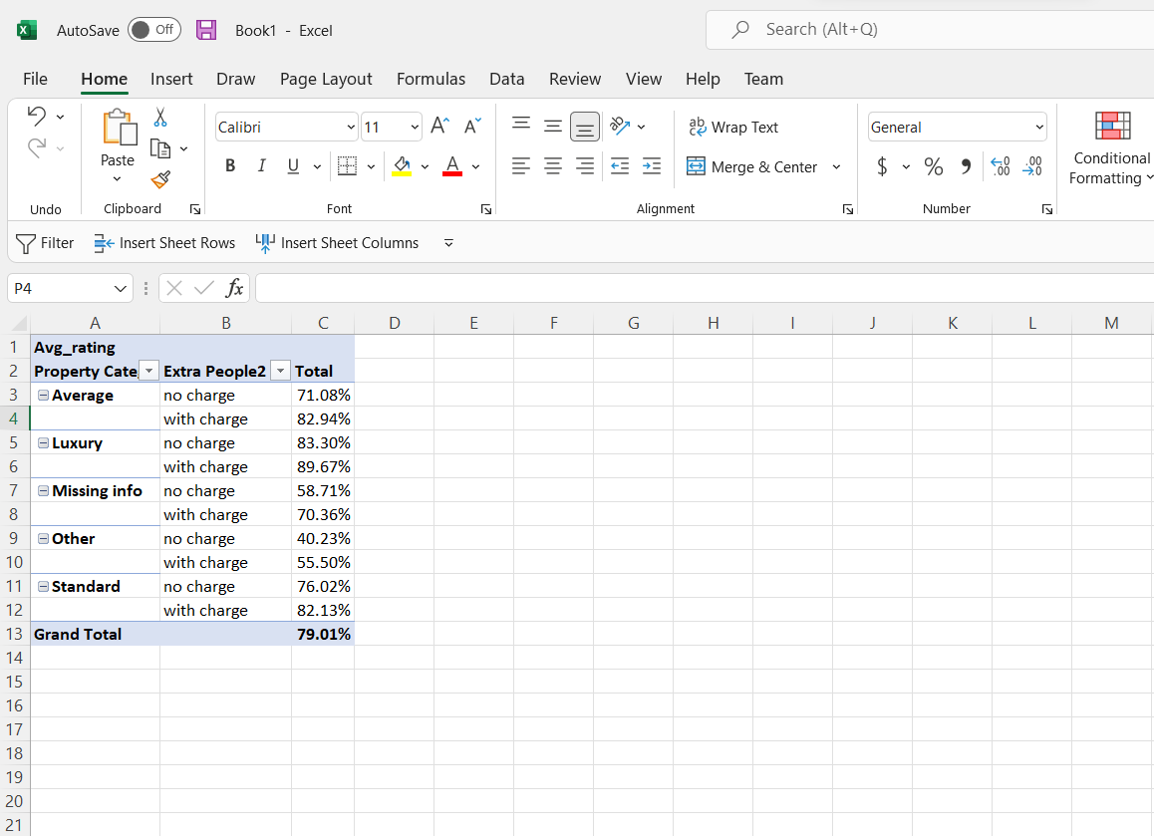
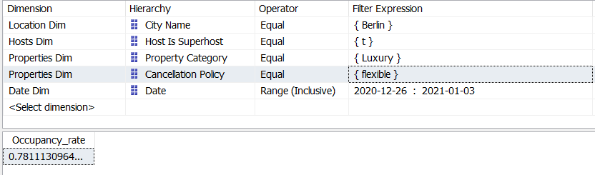
OLAP Reports
Average rating for each property category and for each kind of extra guests charge.
Excel pivot
Occupancy rate of luxury properties in Berlin
that belongs to superhosts and have flexible cancelation policy during Christmas period (26/12/2020 - 03/01/2021).
Slice & dice

Slide 13

LIVE DASHBOARDS

Slide 14
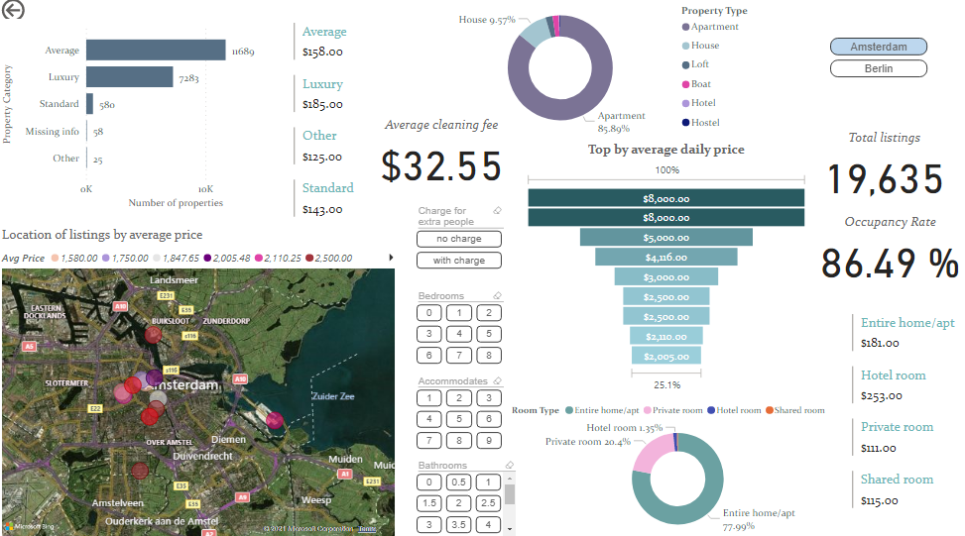
Amsterdam Top priced properties

Slide 15
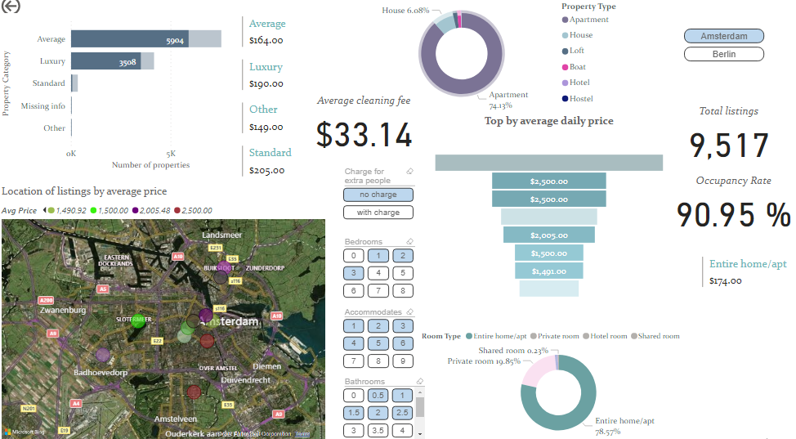
Amsterdam Top priced properties - Entire homes

Slide 16
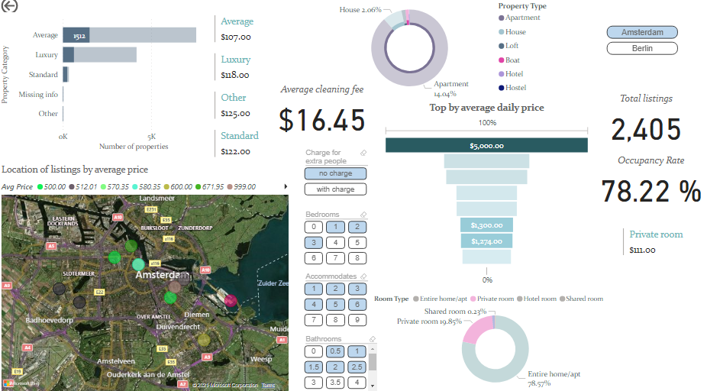
Amsterdam Top priced properties – Private rooms

Slide 17
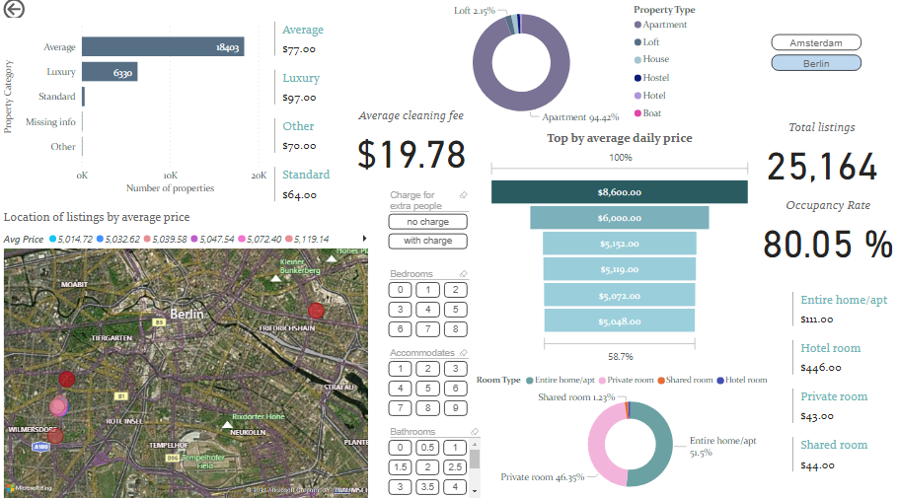
Berlin Top priced properties

Slide 18
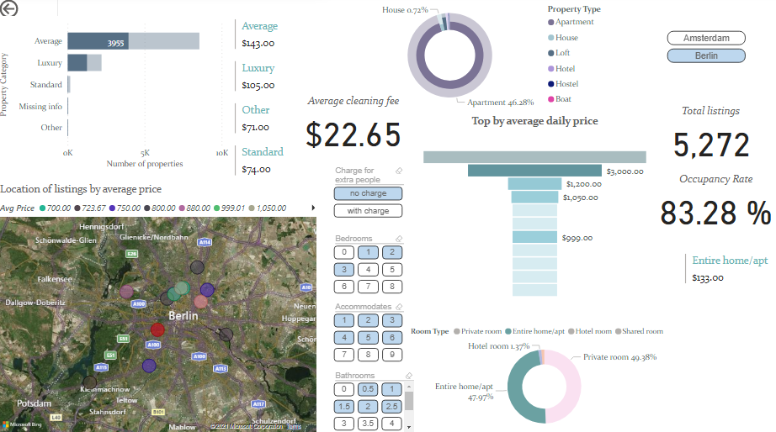
Berlin Top priced properties – Entire homes

Slide 19
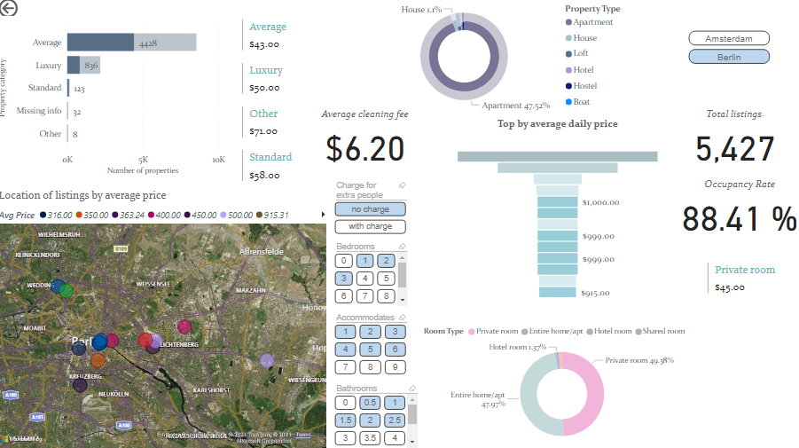
Berlin Top priced properties – Private rooms

Slide 20
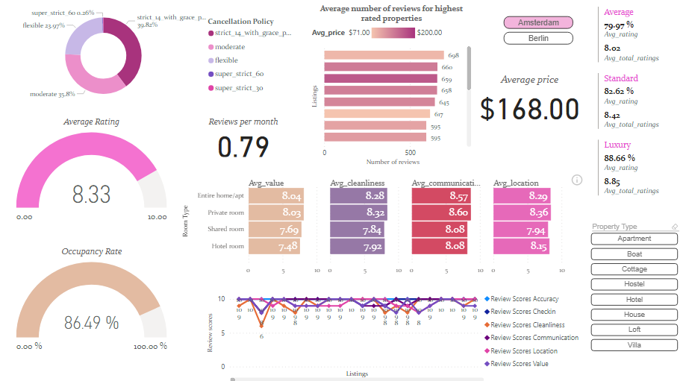
Amsterdam Top rated properties

Slide 21
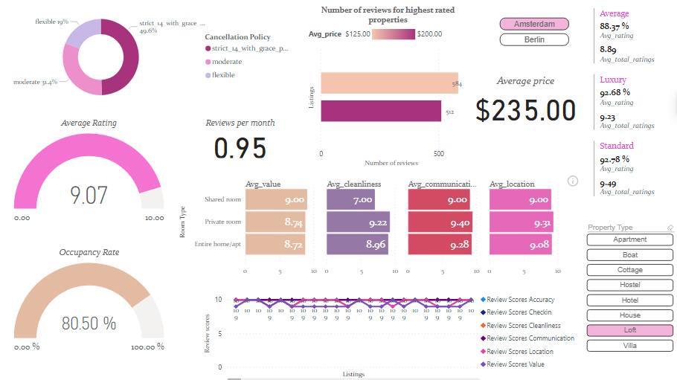
Amsterdam Top rated properties - Lofts

Slide 22
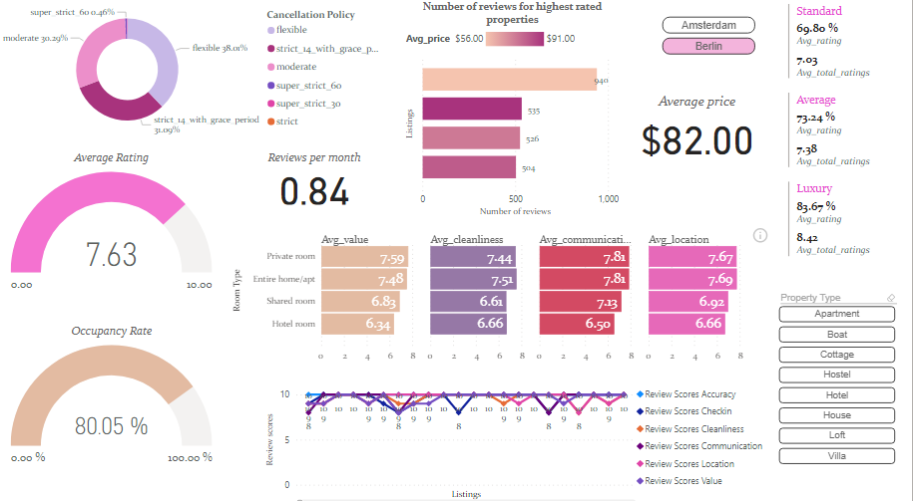
Berlin Top rated properties

Slide 23
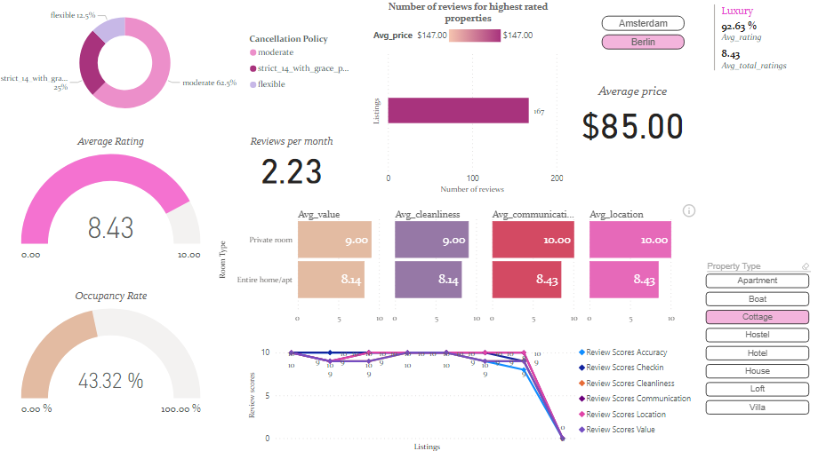
Berlin Top rated properties - Cottage

Slide 24
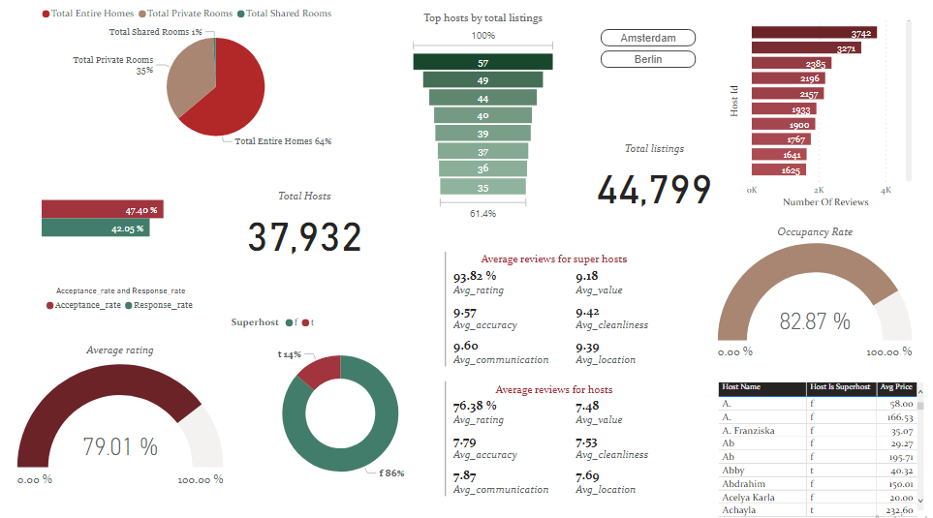
Top hosts

Slide 25
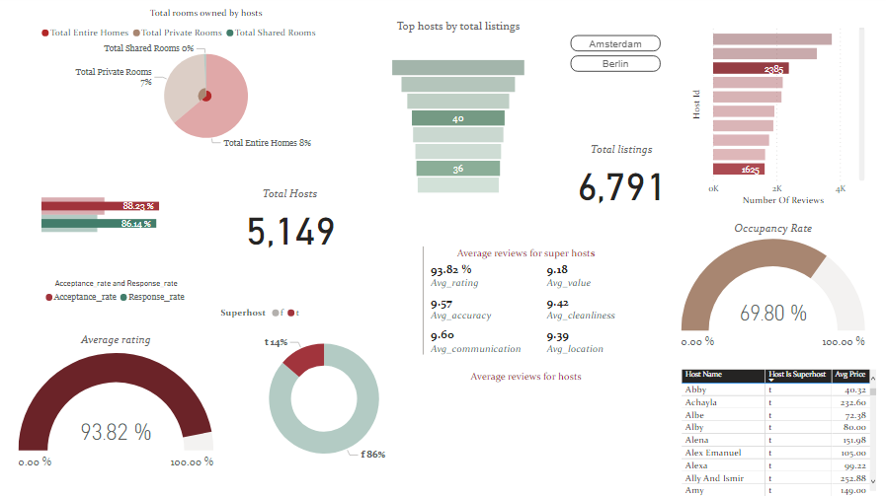
Superhosts

Slide 26
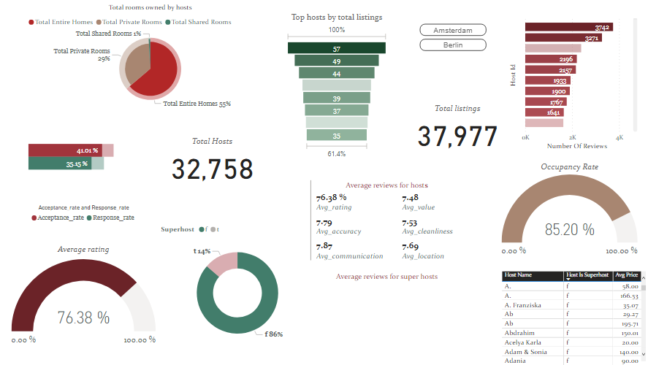
Hosts

Slide 27
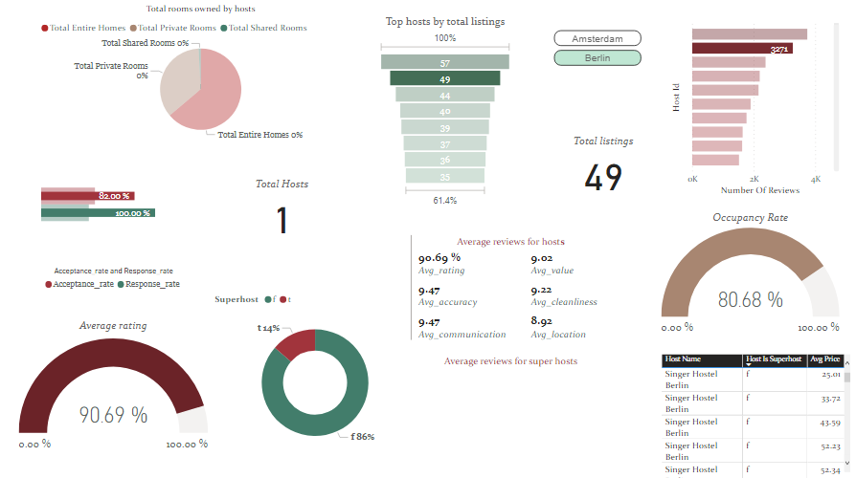
Berlin best host

Slide 28
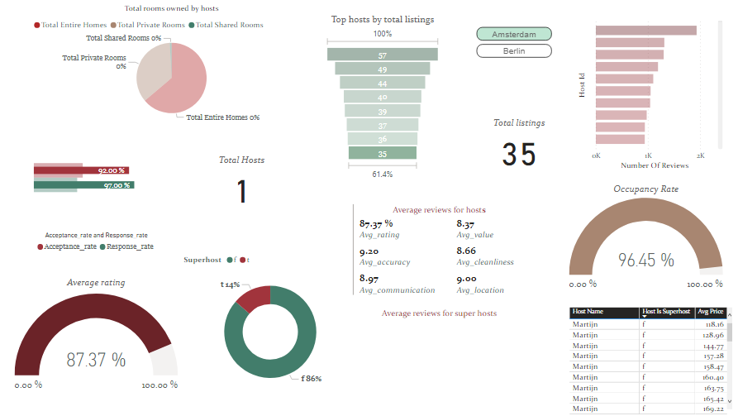
Amsterdam best host

Slide 29
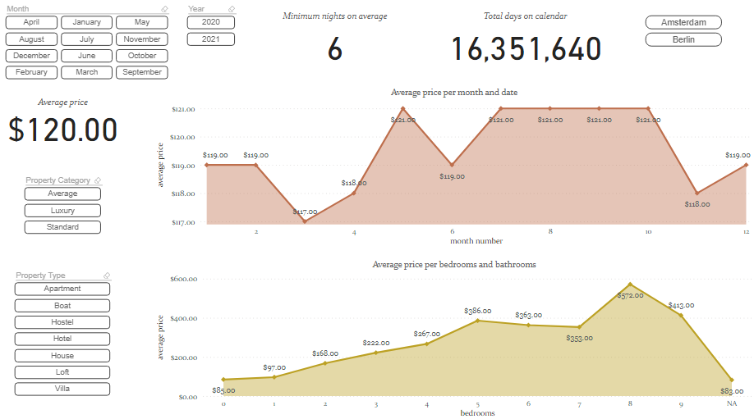
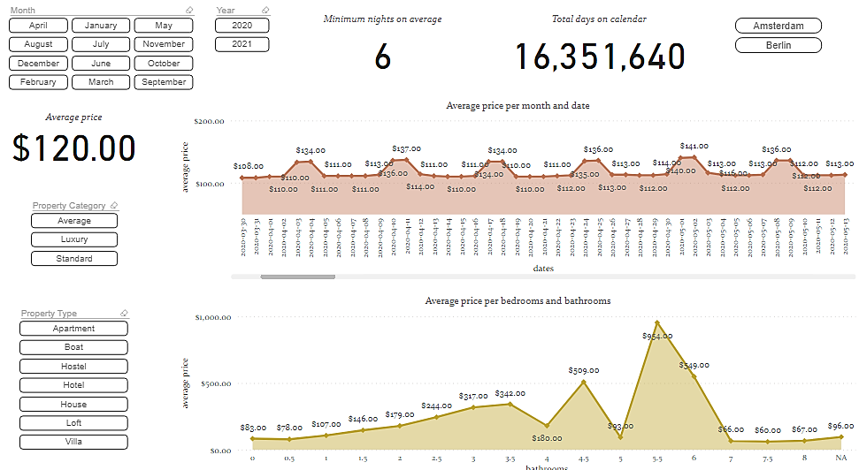
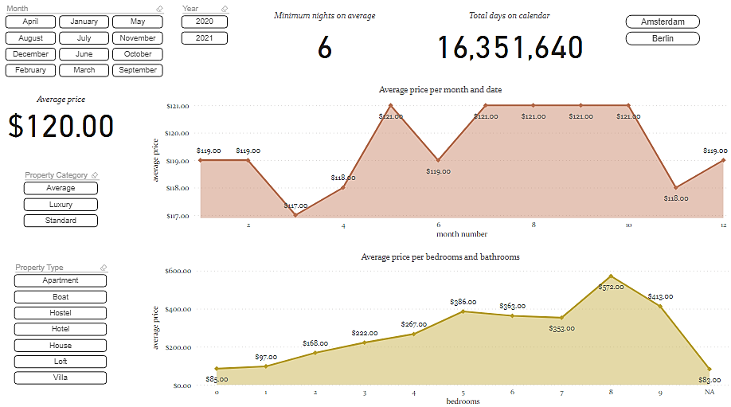
Price distribution

Slide 30
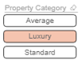
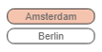
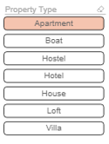
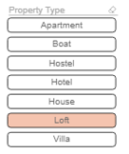
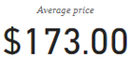
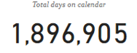
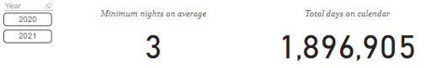
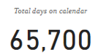
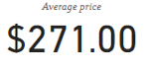
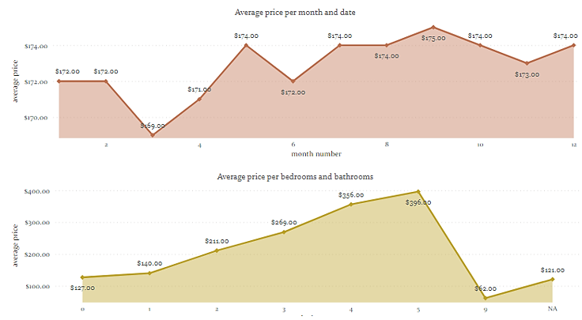
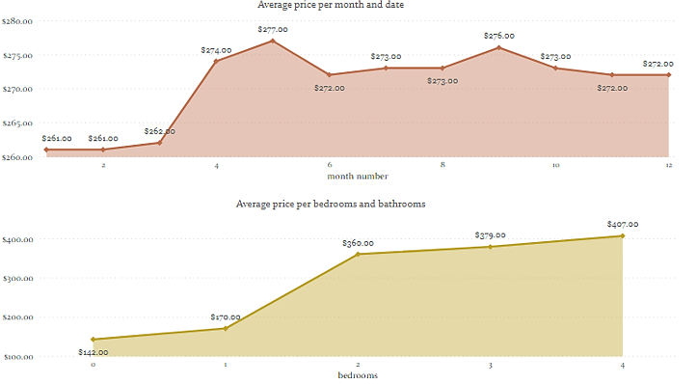
Price - Amsterdam

Slide 31
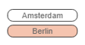
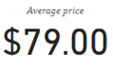
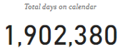
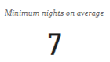
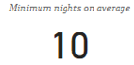
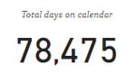
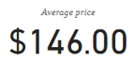
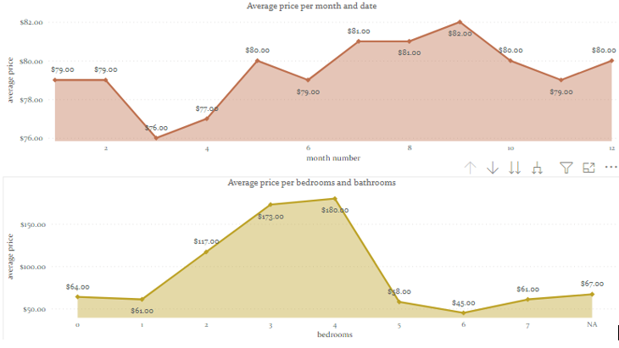
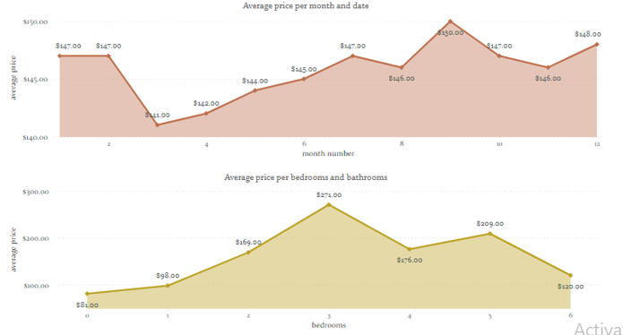
Price - Berlin

Slide 32

Challenges
PROBLEMS
SOLUTIONS
Extract extra information by creating a property category column based on specific properties’ characteristics contained in “amenities”
“Amenities” at staging listings table was free text.
Null values in categorical variables created problems during cube process.
Replacement with NAs
“Extra people” column could not be used as categorical variable since it included metrics
Transform that information and create an extra column with two types of categories.
Months in date dimension table were recognized as categorical variables in power BI.
Change table’s properties in order to have chronological sequence in our charts.
Limited capabilities of Power BI due to live connection with SSAS
Create new measures and transfer some metrics from fact tables to dimensions
Not all dimensions were connected with prices in staging calendar table.
Multiple trials to conclude to the right schema (dimensions and fact tables).

Slide 33
Findings
Prices in Amsterdam > Prices in Berlin
Prices of hotel rooms > Prices of other room types
Prices of shared rooms < Prices of other room types
Review scores /ratings for shared rooms /hotel rooms < Other review scores
Prices of luxury properties > Prices of other properties
Prices of lofts > Prices of apartments
High prices do not always correspond to high ratings and quality
Low prices are mostly accompanied with average ratings.
Summer months and weekends have generally higher prices.
The more bedrooms and bathrooms, the higher the price, but after a certain number, the price falls.
Superhosts have higher ratings, scores, response/acceptance rates more trusted within the community
Most top hosts are located in Berlin and are not superhosts

Slide 34

Thank you for your attention
Any Questions?

